Slide 1
JOT BIKE
Management System
GROUP 4
K220380 | Thi Ngoc Quynh Ho
K221578 | Erna Halim
K220685 | Hendra Lim
K220411 | Alyxandra Marie Sarmiento
K210810 | Wangsu Tamang

Slide 2
Table of contents
01
02
03
04
05
06
Project Description
System Analysis and Requirements
Database Design
User Interface Design
Test Plan & System Implementation Plan
Feedback

Slide 3

01
Project Description

Slide 4
1.1 Business Case
Jot Bikes is Australia’s leading provider of electric bikes and scooters, offering both short-term rentals and direct sales. As the business expands, its current manual and fragmented systems for managing bookings, inventory, vendors, and customer data have become inefficient. These issues lead to booking overlaps, stock mismanagement, and customer dissatisfaction. To maintain competitiveness and improve service delivery, Jot Bikes requires a modern, web-based management solution that automates internal operations and provides real-time access to key services for customers, administrators, and vendors. This solution follows industry-recognized best practices in web development, security, and data privacy compliance (OWASP 2024), (OAIC 2024).

Slide 5
1.2 Purpose and Objectives
The purpose of the Jot Bikes Management System (JBMS) is to streamline operations and enhance customer and vendor experiences through digital transformation. The key objectives are:
Centralised Management: Build a web-based system to manage bike inventory, rental and sales records, vendor listings, and customer accounts in a single platform.
Automated Booking and Secure Payment: Enable customers to search, book, and securely pay online, improving convenience and accuracy.
Customer Engagement (CRM): Integrate automated notifications, feedback systems, and booking history to foster better communication and retention.
Vendor Management Module: Provide a dashboard for vendors to manage bike listings and track bookings in real time.
Analytics and Reporting: Equip administrators with dashboards for monitoring rental/sales trends, customer behaviour, and vendor performance.
These objectives align with modern web development standards and ensure scalability and data protection in compliance with Australian regulations.

Slide 6
1.3 Detailed Scope
Login and registration: Admin, Customers and Vendors can login and register on the system with unique User ID/ email and password.
Manage:
Vendor: Admins can update and view the vendors’ information, including add and delete them in the system.
Bike: Both Admin and Vendor can update and delete bikes’ information. However, only Admin can add bikes’ data such as: availability.
View:
Booking: both Admin and Vendor can view the booked products.
Feedback: Admin can view the customers’ feedback.
Users: Admin can view the customers’ information, including add, delete, and update.
Users:
Check bikes availability: customer can check the products’ details, including its availability.
Book and pay: users can book and pay on the website.
Encryption & Security: AES Security Encryption, firewall, SSL certificates, MFA, Payment Gateway and HTTPS are used to protect sensitive data and session cookies.
Notification System: notifications function for Admin, Vendor and Customers for reminding.

Slide 7
1.4 Proposed System Design Specifications
The system will be developed using the MERN Stack. The MERN stack was selected for its unified use of JavaScript, which allow seamless integration between front-end and back-end. It also supports rapid prototyping, scalability, and is widely adopted in modern web application development (Vipul A. M; Prathamesh Sonpatki 2016). TailwindCSS is used for fast and responsive design (Tailwind CSS - Rapidly build modern websites without ever leaving your HTML. n.d.).
Frontend: React.js with TailwindCSS for styling. Responsive design using grid/flex layouts and component-based structure. Axios will be used for API calls.
Backend: Node.js with Express.js to provide RESTful API endpoints for secure communication, session handling, and validation.
Database: MongoDB (hosted via MongoDB Atlas) to store bike data, user profiles, booking records, and vendor details in a flexible schema.
Security: JWT-based session management, secure form validation, XSS/CSRF protection via middleware, and AES encryption for sensitive data.
Deployment: Hosted on Vercel (frontend) and Render/Heroku or AWS (backend), with GitHub for CI/CD version control and collaboration.

Slide 8
1.5 Methodology
The project follows an Agile methodology using the Scrum framework, enabling iterative development, weekly progress tracking, and flexible change handling. This includes:
Sprint Planning: Defined goals and backlog grooming every two weeks.
Daily Stand-ups: Regular team check-ins to track blockers and sync progress.
Version Control: All work tracked using GitHub with branching and pull requests.
Design and Prototyping: Wireframes and UI mockups built in Figma, tested iteratively with feedback from team and stakeholders.
Testing: Unit, integration, and system testing conducted during development using Jest and Postman.
Deployment & Review: Final system deployed to live environments with stakeholder walkthrough and UAT before final handover.
Documentation: Admin and user manuals, installation guide, and technical documentation will be delivered at project completion.

Slide 9
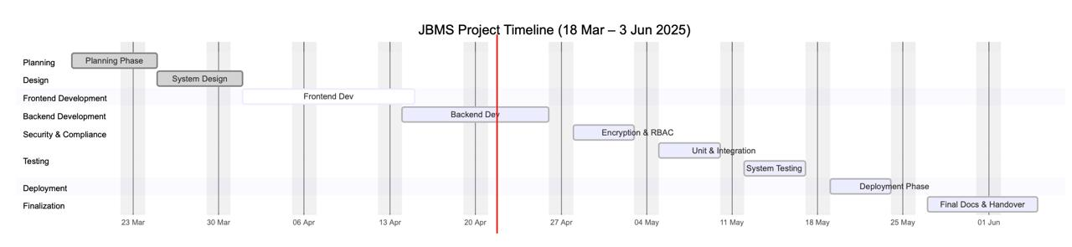
JBMS Project Timeline

Slide 10
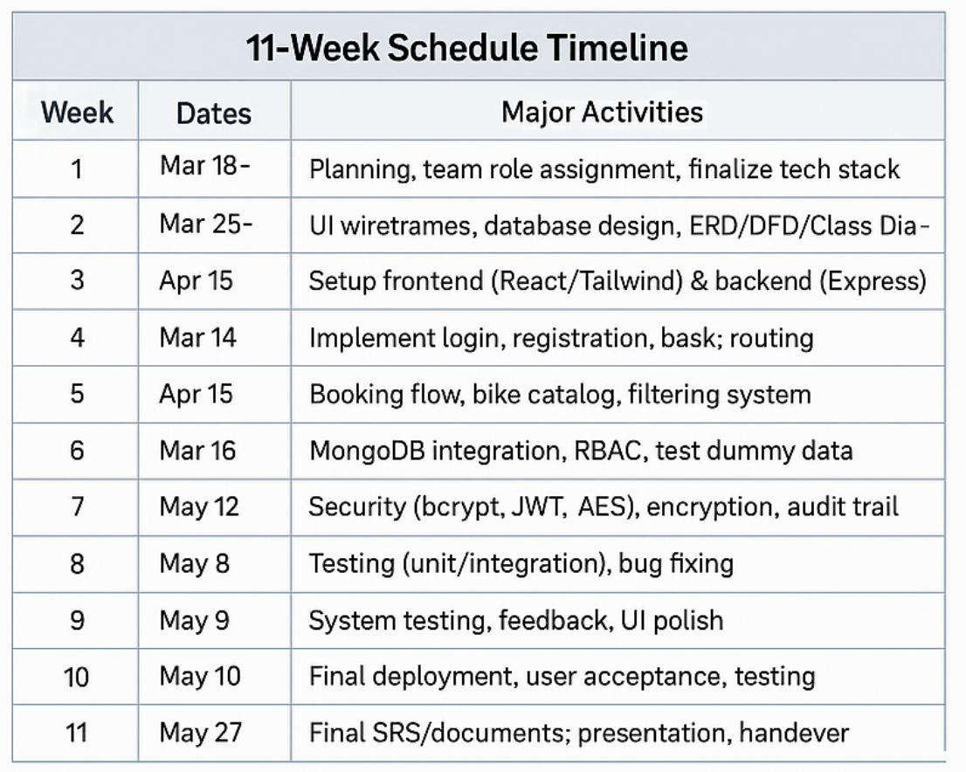

Slide 11

2
System Analysis and Requirements

Slide 12
2.1 Software & Hardware Requirements
The hardware requirements:
Processor: A window system CPU with intel core i5 (at least) multi processor, however, recommended i7.
RAM: 8GM RAM is recommended.
External storage: A hard drive with 256GB backup storage.
Other tools: Keyboard, mouse, monitor, printer, and scanner.
The software requirements:
Operating system:
Window: Windows 10 or later version.
MacBook: MacOS 13 Ventura version or later version.
MongoDB: this JBMS will use a free open source called Community Server.
A compatible web browser:
Window: Chrome, Microsoft Edge and Firefox.
MacBook: Safari

Slide 13
2.2 Functional & Non-Functional Requirements
FUNCTIONAL REQUIREMENTS
Inventory Management Tracking Bikes Adding/ Removing Bikes Inventory Alerts Rental Management Booking and Scheduling Rental Agreements Payment Processing Rental check-in and check-out Extension of Rentals Sales Management Product Catalogue Sale Transactions Customer Database | Customer Relationship Management (CRM) Customer Profiles Communication Reporting and Analytics Sales Reports Rental Reports Inventory Reports Other Functions Integration with online booking platforms User roles and permissions Security Customization

Slide 14
2.2 Functional & Non-Functional Requirements
NON-FUNCTIONAL REQUIREMENTS
Responsiveness Privacy Security Scalability Reliability | Quality Documentation Response Time Maintainability Performance

Slide 15
2.3 User Requirements
The use cases of JBMS demonstrate how the users (such as: Admin, Vendor, and Customers) and stakeholders are involved in the system. The use cases of JBMS demonstrate how the users (such as: Admin, Vendor, and Customers) and stakeholders are involved in the system.

Slide 16
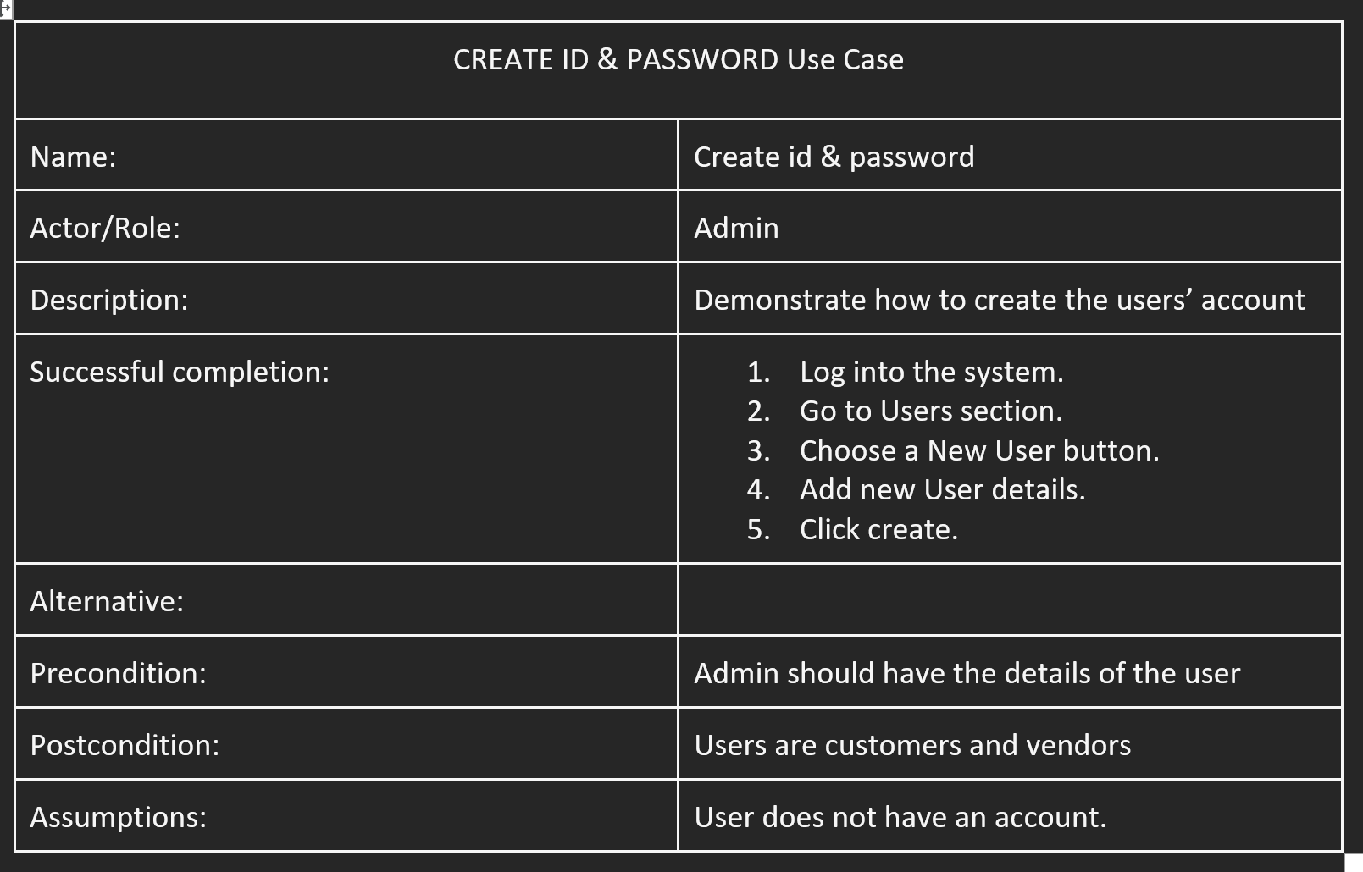
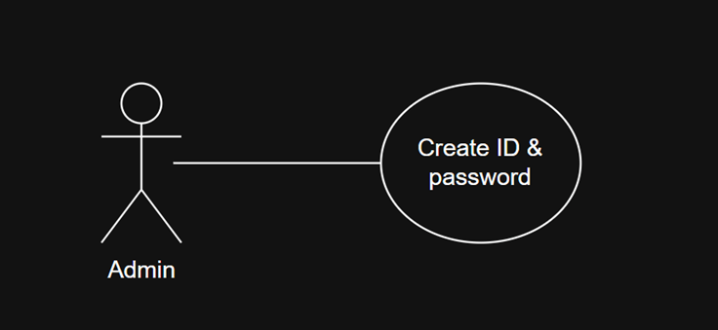
CREATE ID & PASSWORD

Slide 17
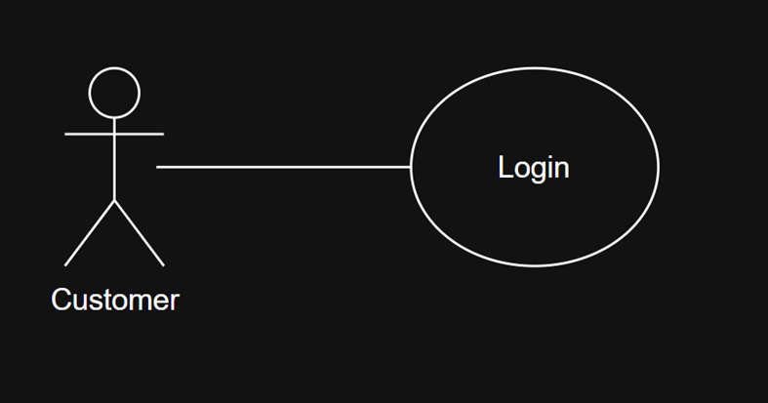
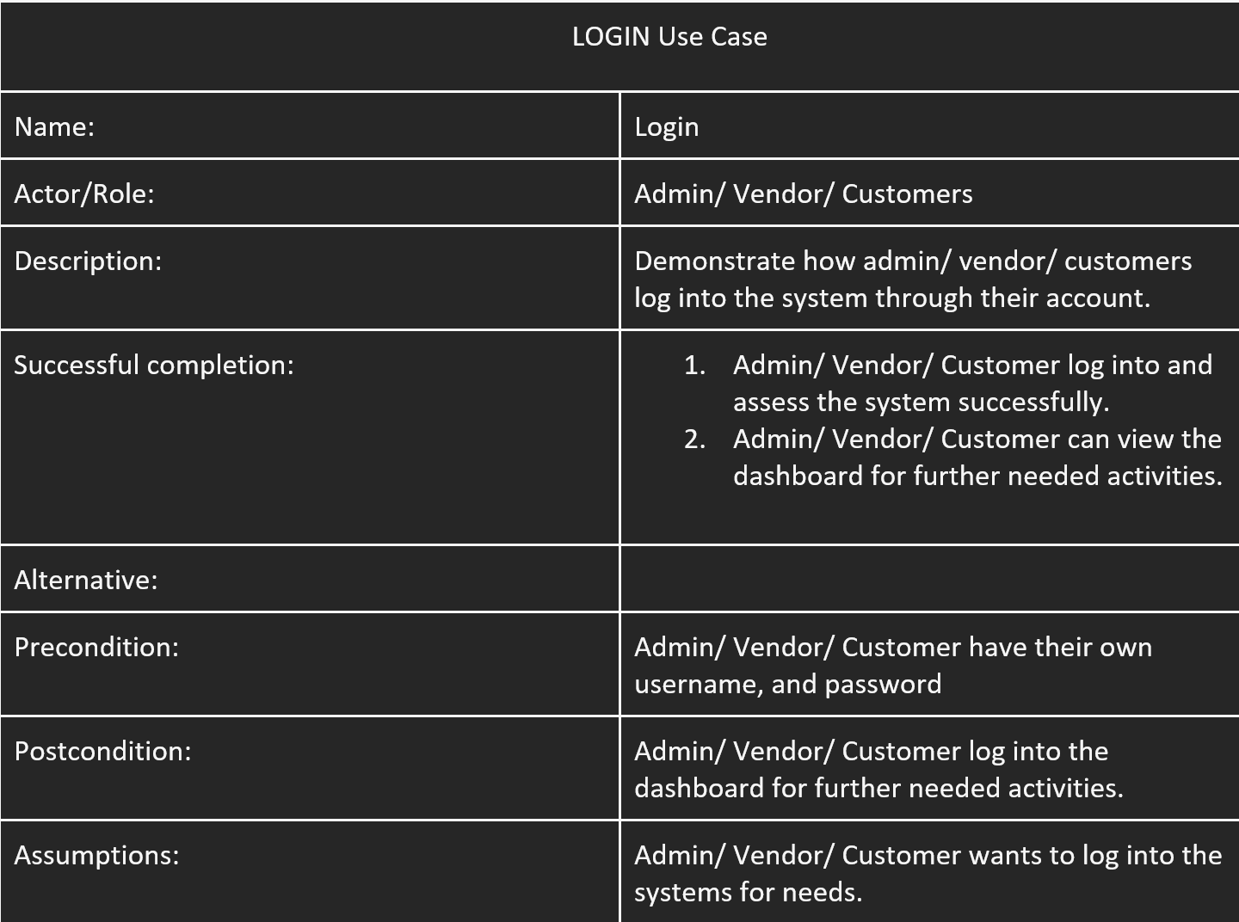
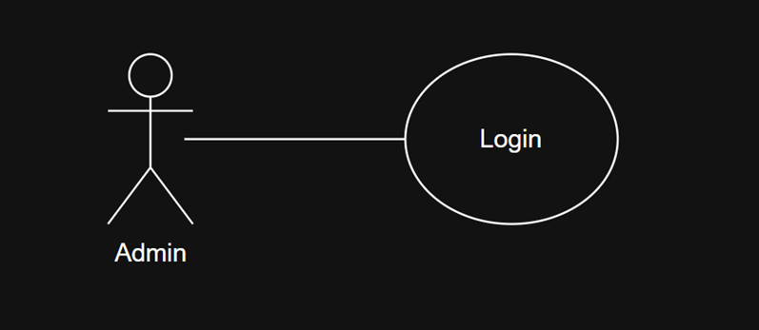
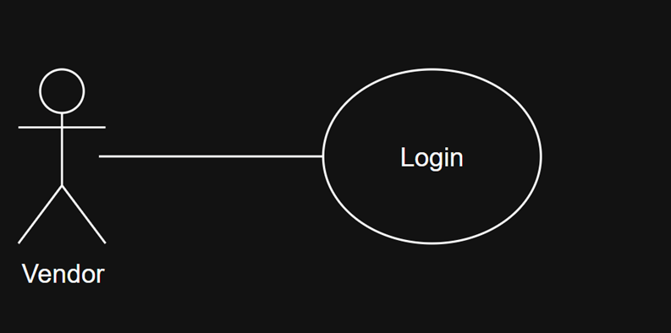
LOGIN

Slide 18
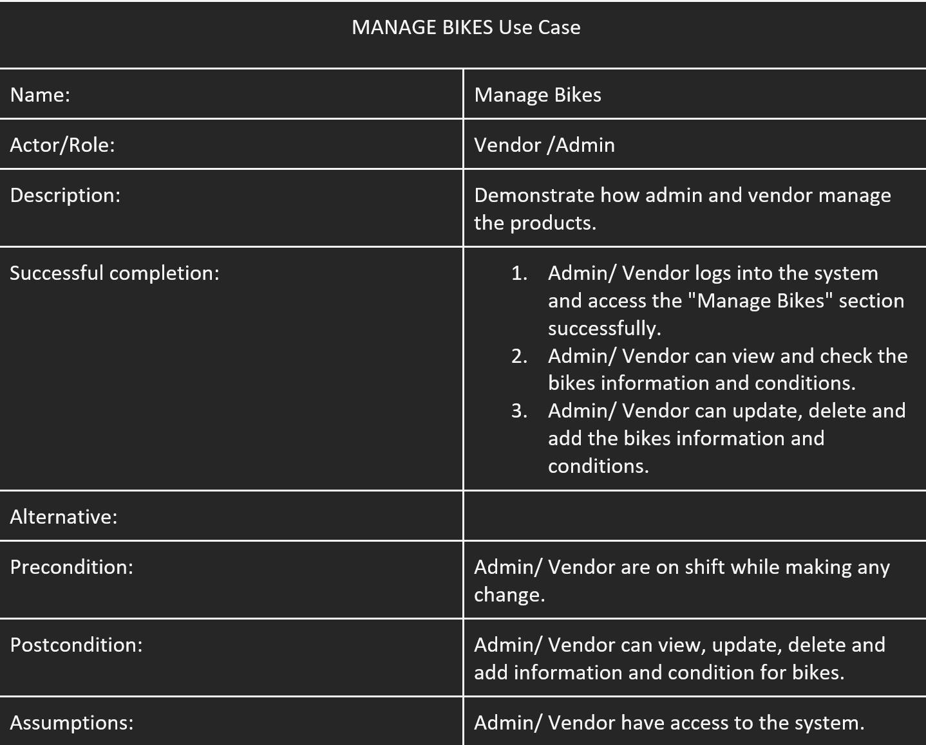
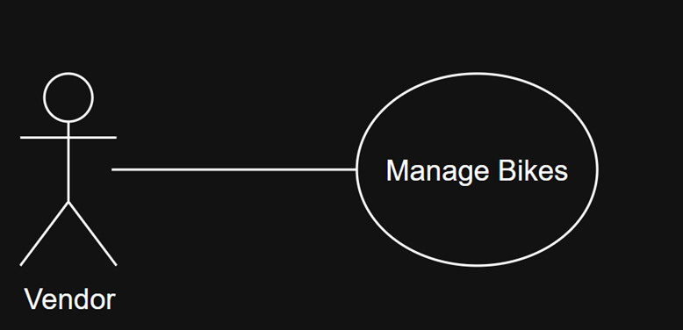
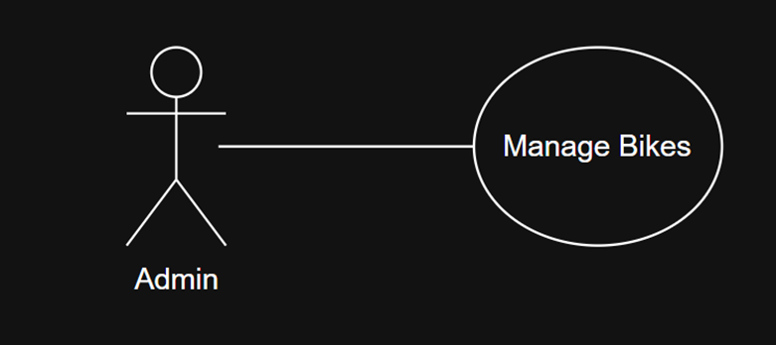
MANAGE BIKES

Slide 19
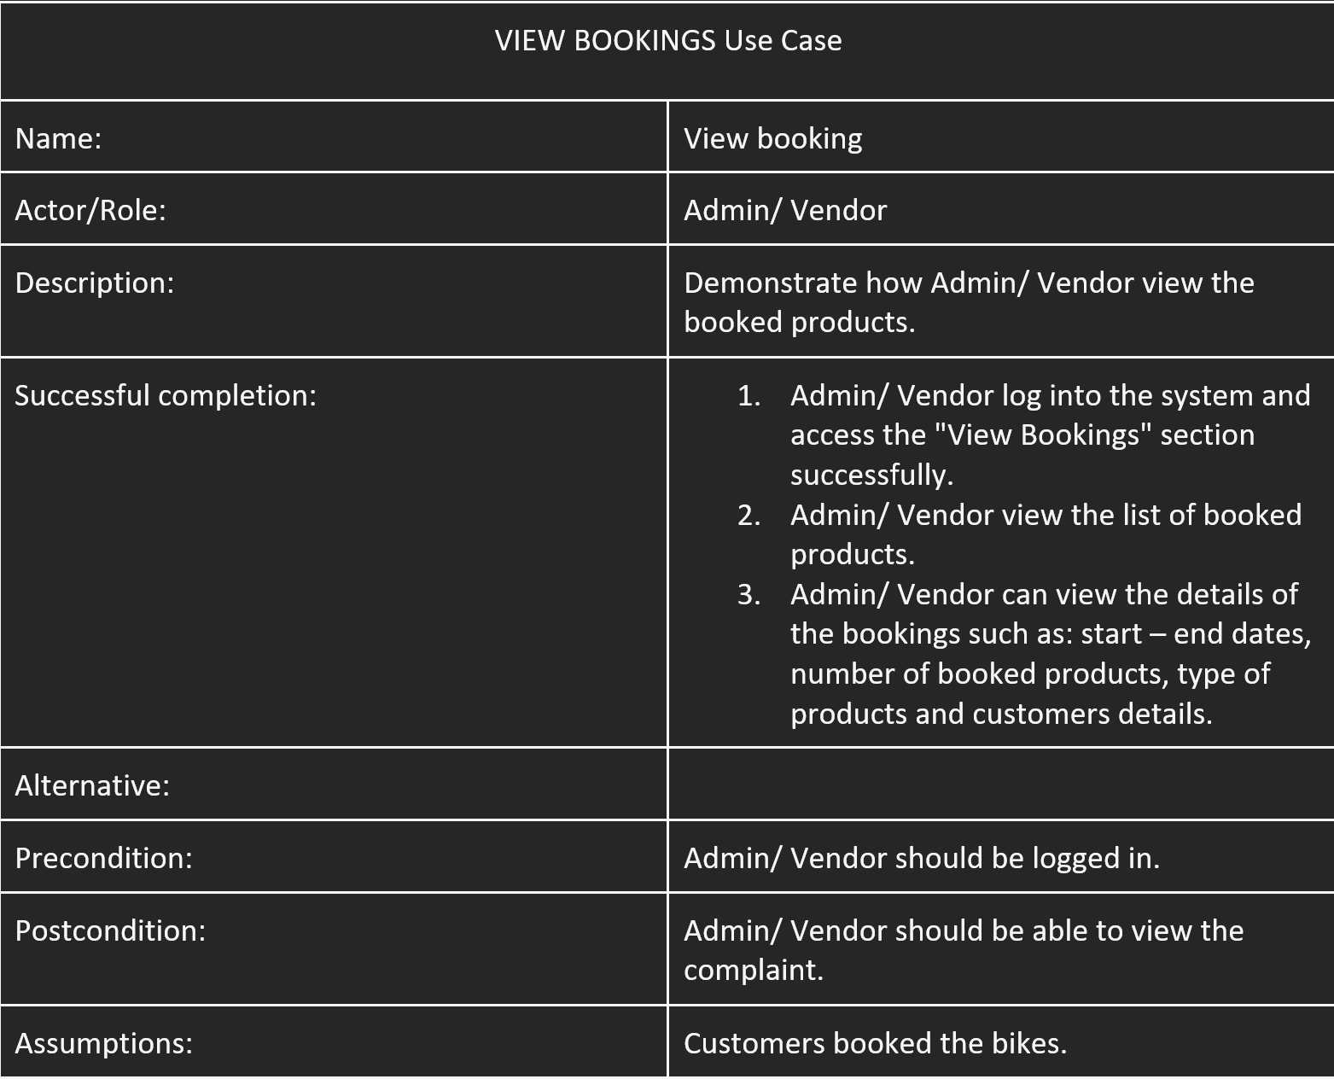
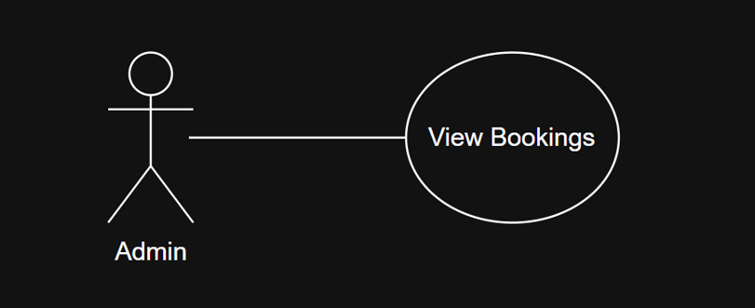
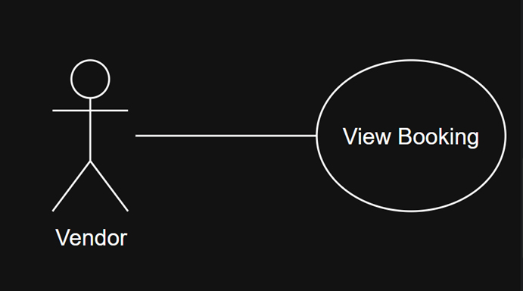
VIEW BOOKING

Slide 20
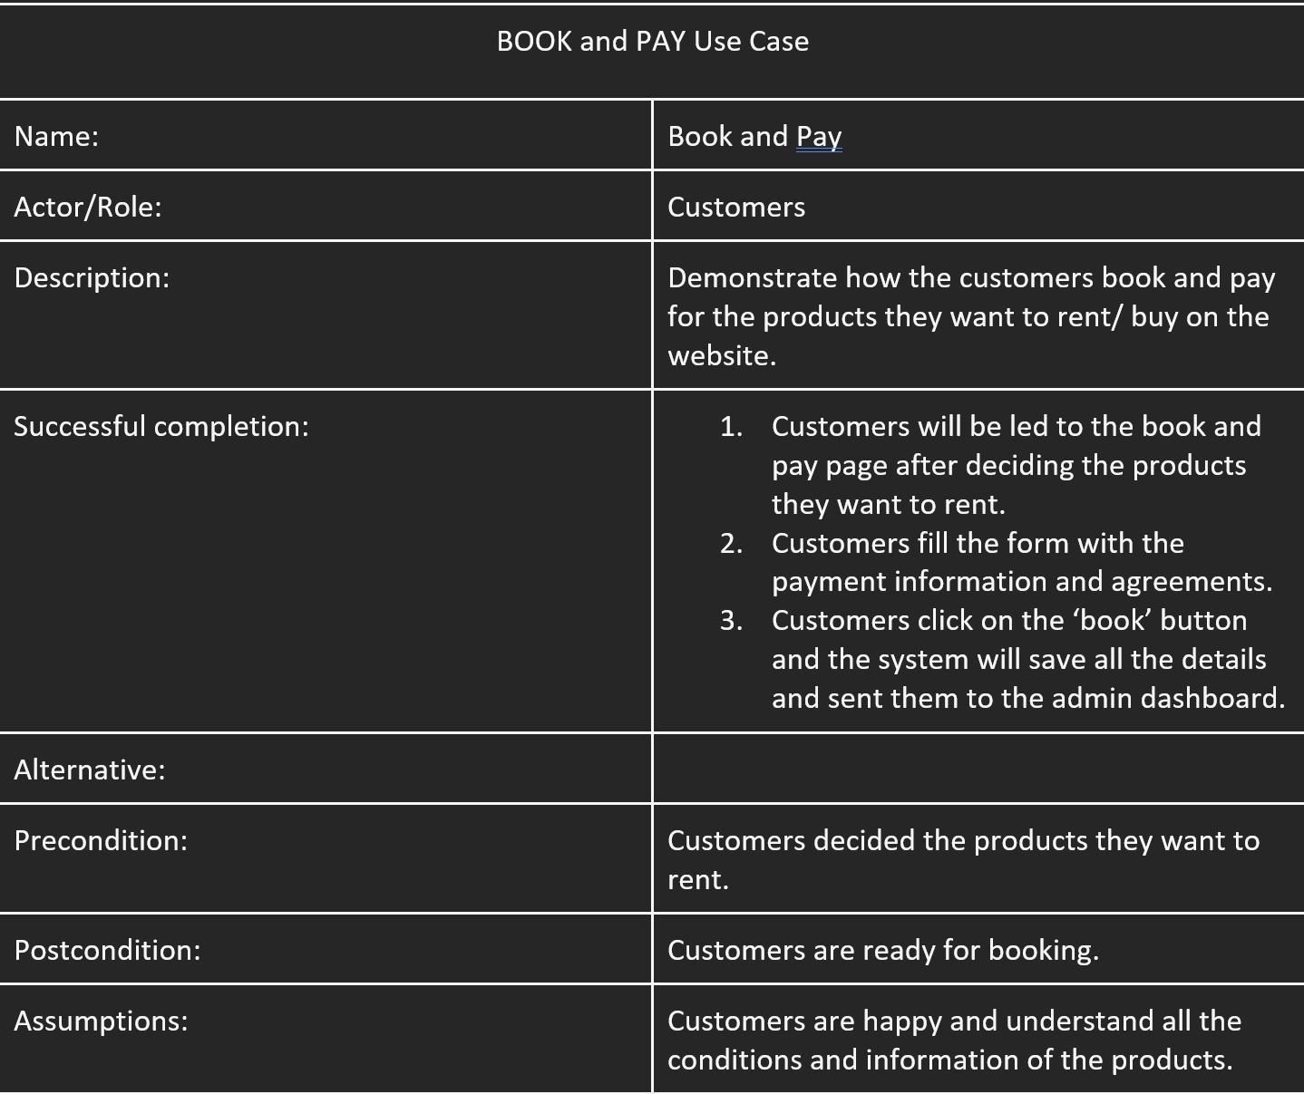
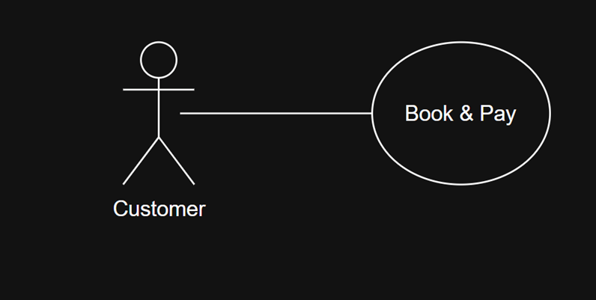
BOOKING & PAYMENT

Slide 21
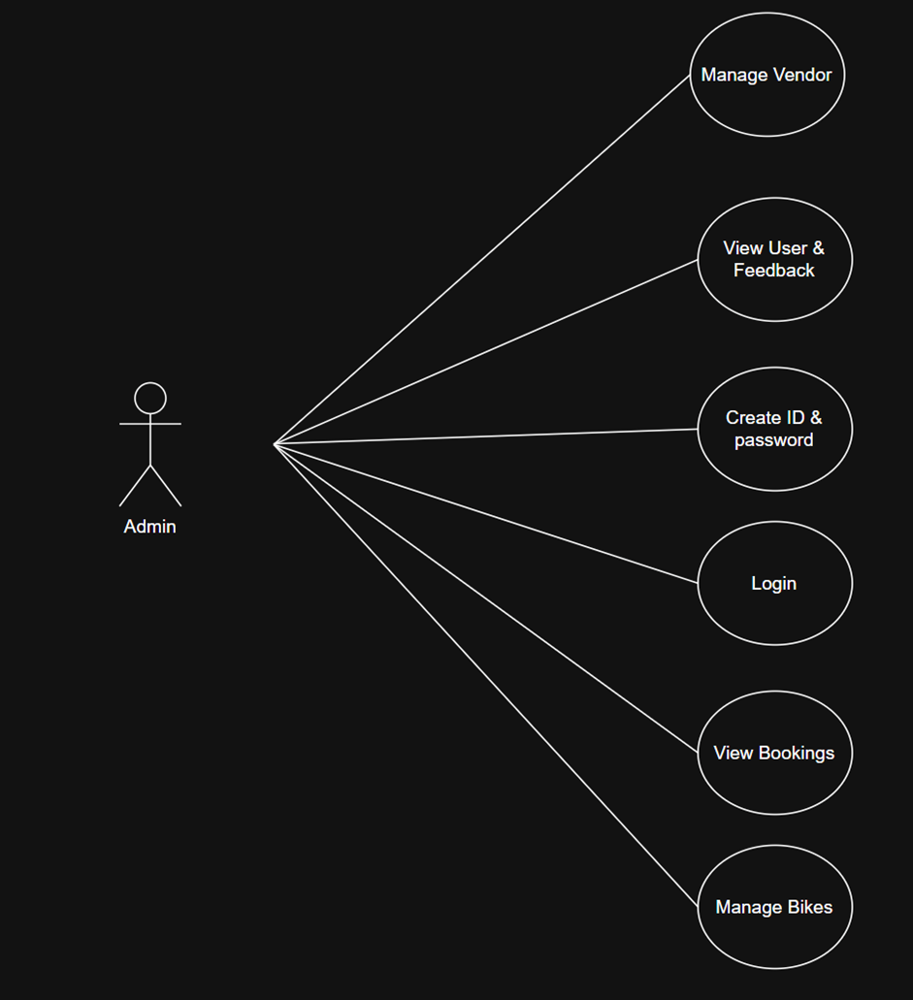
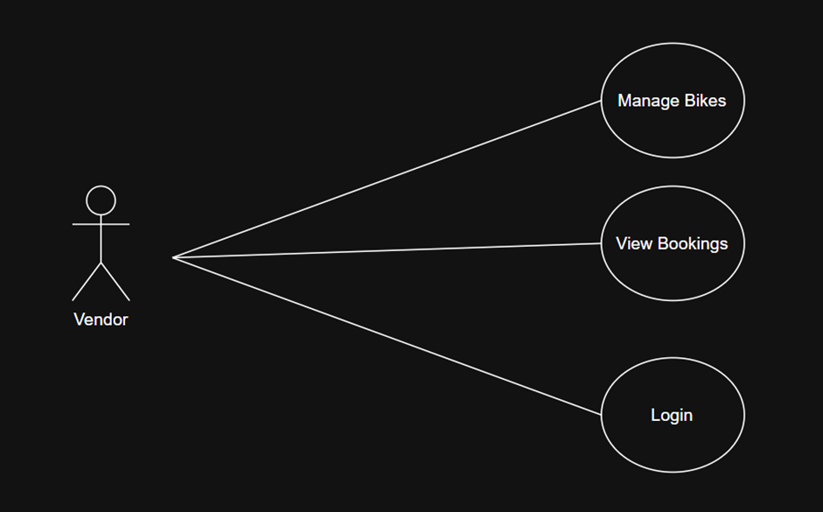
2.3.1 Use Cases

Slide 22
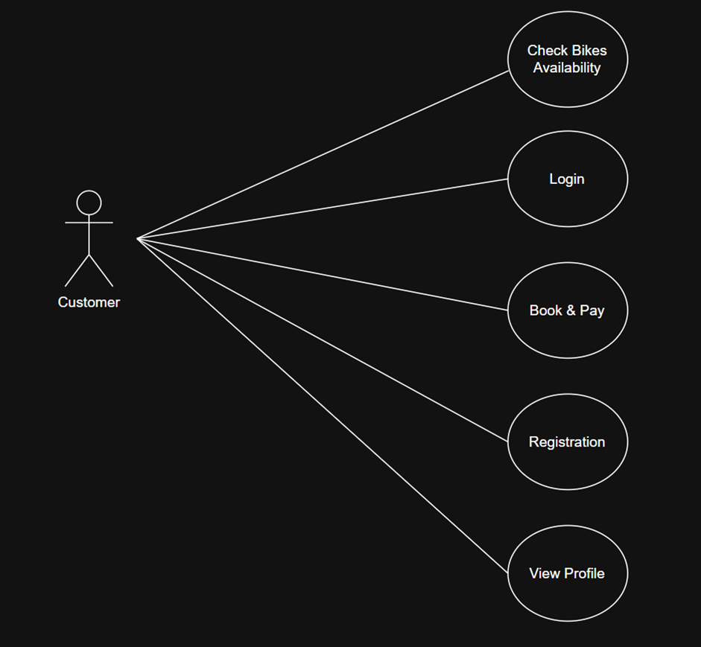
2.3.1 Use Cases

Slide 23

3
Database Design

Slide 24
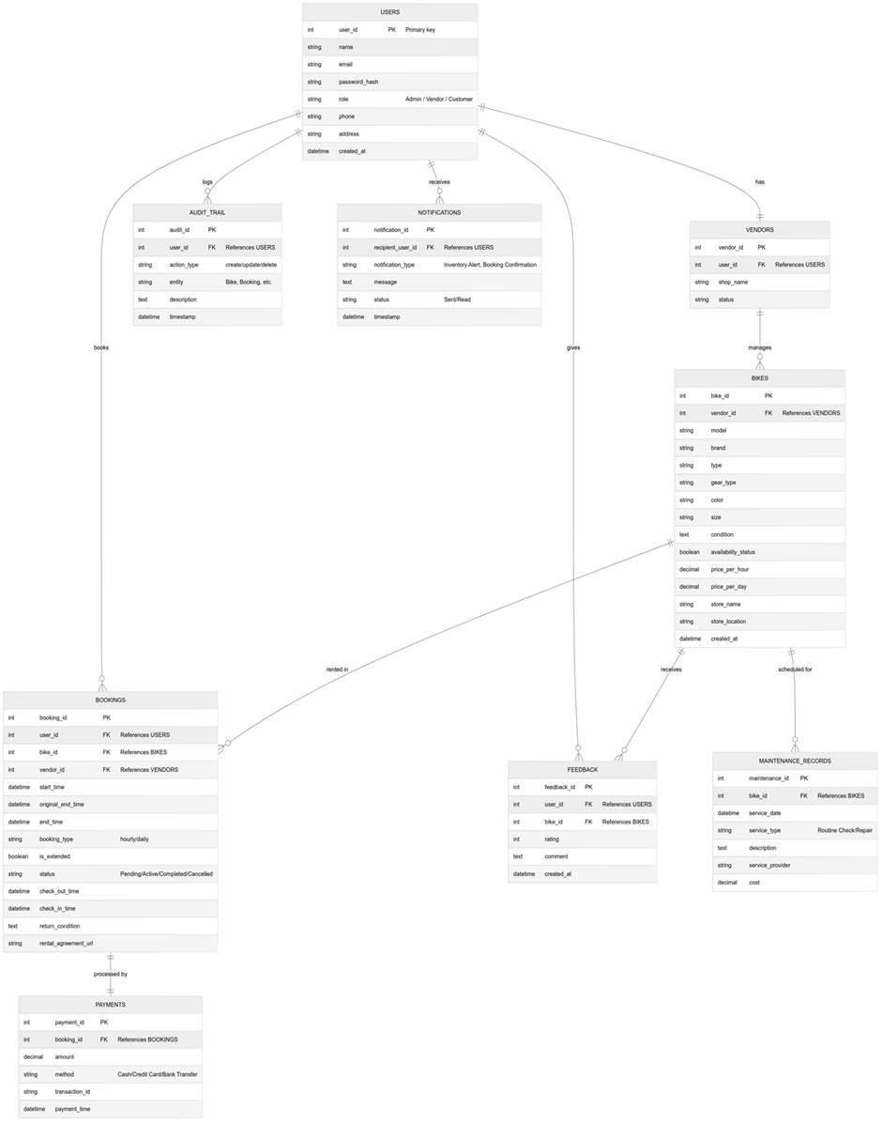
3.1 Entity Relationship Diagram (ERD)
Fig. ER Diagram

Slide 25
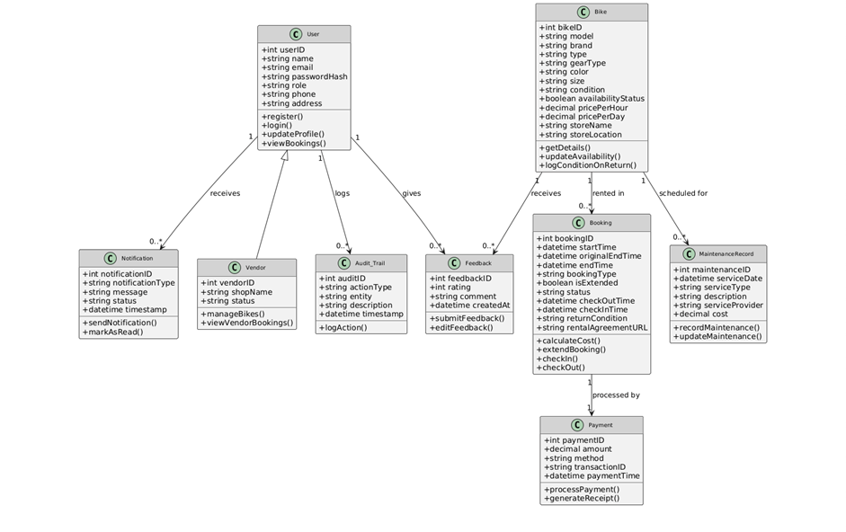
The database is designed using a NoSQL schema structure using MongoDB. Collections such as Users, Products, Bookings, and Feedback are stored as a JSON-like documents, allowing schema flexibility and fast retrieval. This document-based design is ideal for application like JBMS where field may vary such as vendor specific bikes and scalability is crucial Team (2025).
Fig. Class Diagram

Slide 26
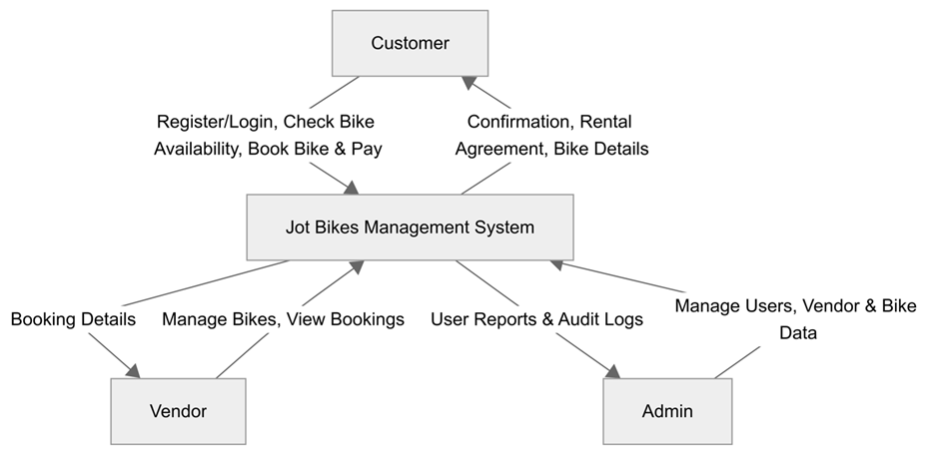
3.2 Data Flow Diagram (DFD)
Fig. Data Flow Diagram Level 0

Slide 27
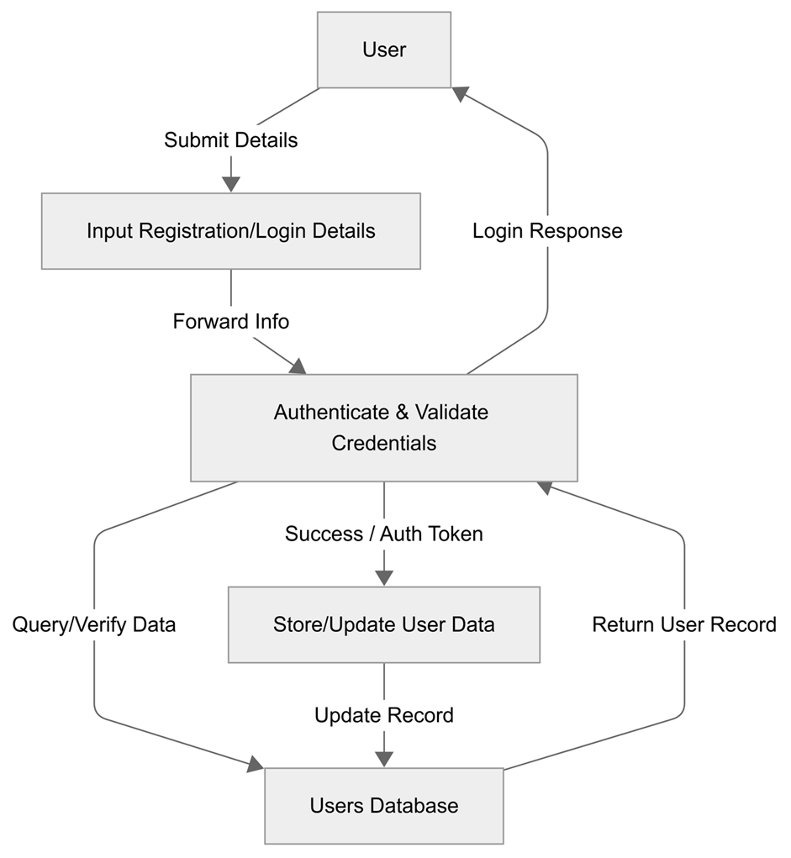
Fig. Data Flow Diagram Level 1 -
User registration and Login

Slide 28
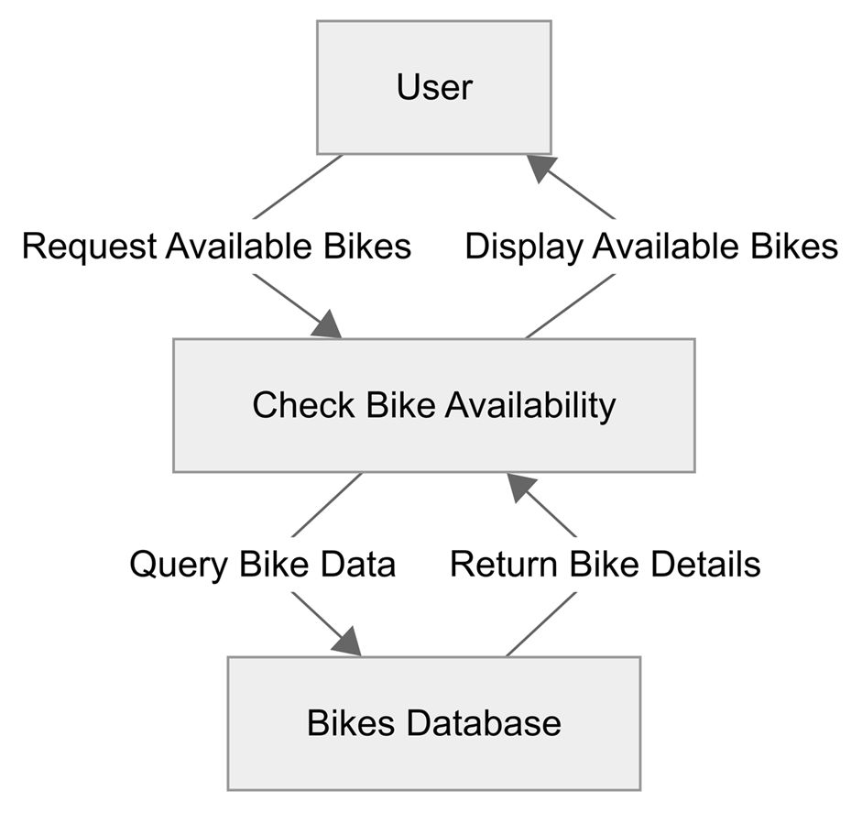
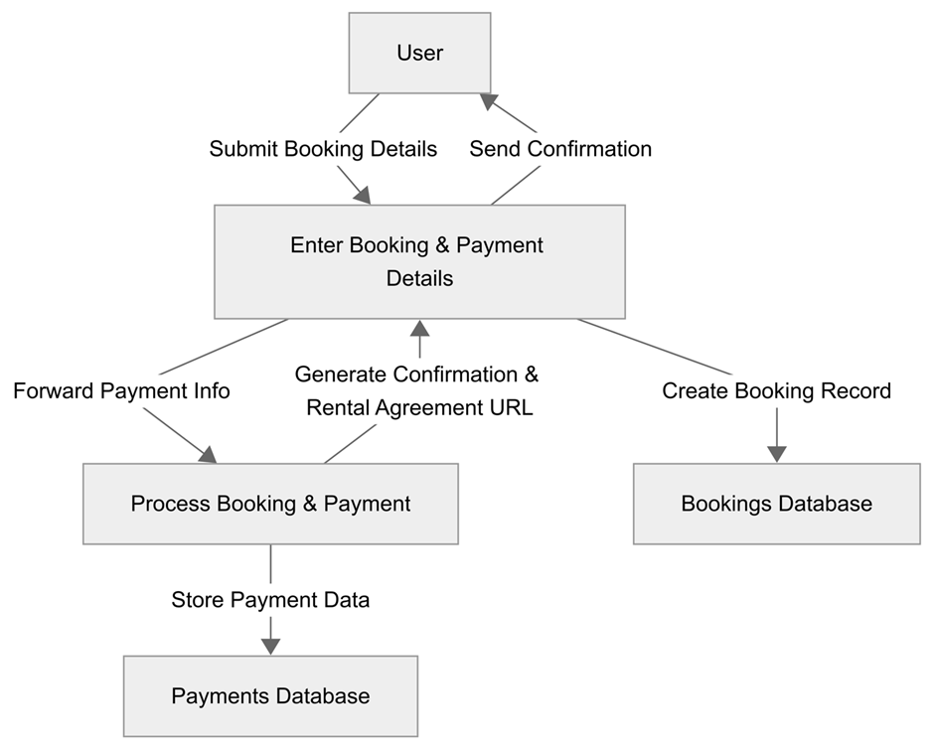
Fig. Data Flow Diagram Level 1 -
Check Bike Availability
Fig. Data Flow Diagram Level 1 -
Book and Pay

Slide 29
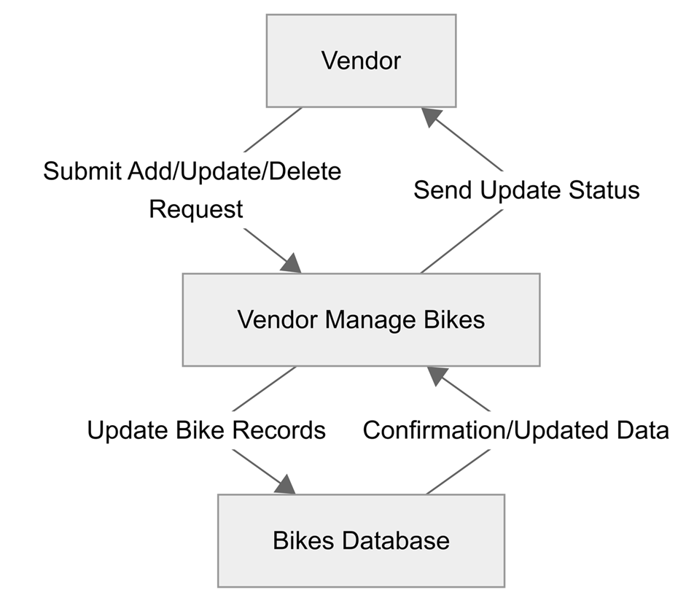
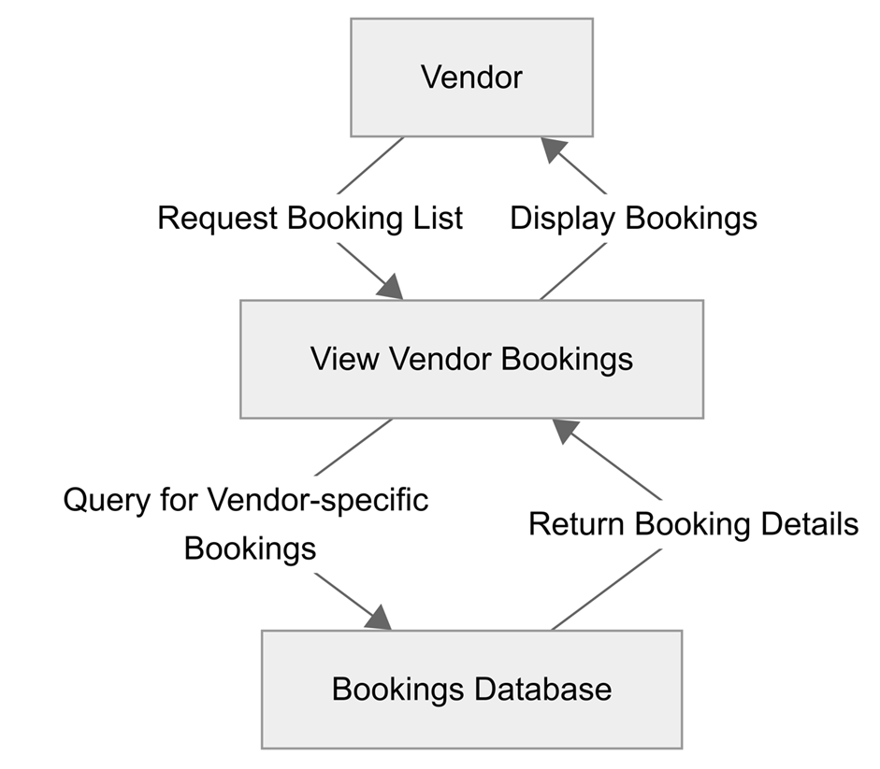
Fig. Data Flow Diagram Level 1 -
Vendor Manage Bikes
Fig. Data Flow Diagram Level 1 -
Vendor View Bookings

Slide 30
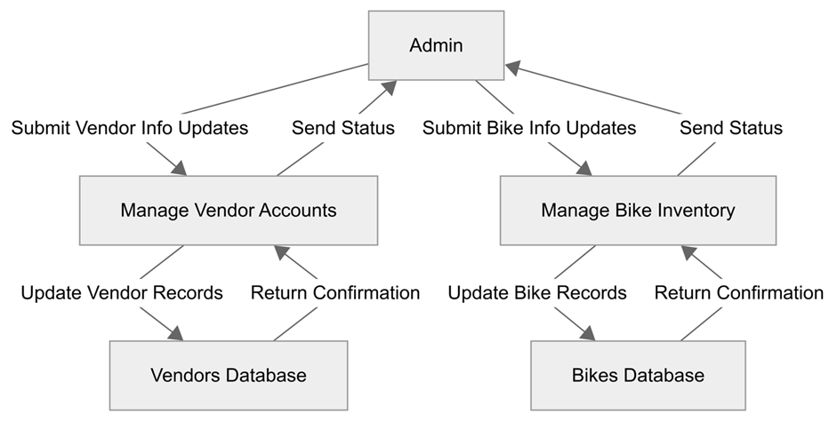
Fig. Data Flow Diagram Level 1 - Admin Manage Vendor

Slide 31
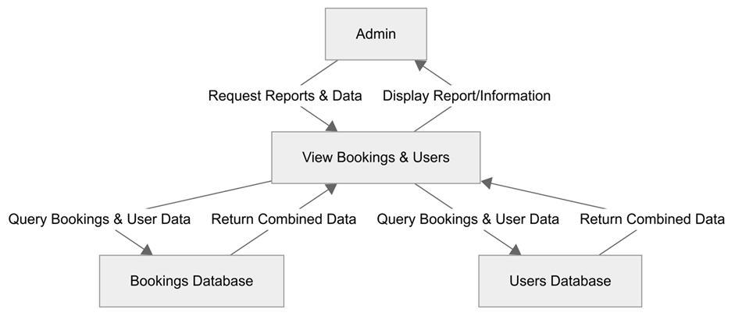
Fig. Data Flow Diagram Level 1 - Admin Manage Bikes

Slide 32
3.3 Security Implementation
CIA (Confidentiality, Integrity, and Availability) must be adhered to when designing and implementing a website. For Jot Bikes Rental Management System, a multi-layered security approach has been implemented. This system consists of BCrypt which is used for secure password hashing, AES-256 encryption for sensitive data, data anonymization for privacy-compliant analytics, and RBAC (Role-Based Access Control) to ensure user has access based on their assigned role. Additionally, following industry best practice as recommended by OWASP and NIST. Secure Communication (HTTPS/SSL), environment-based key management, and having a proper admin activity login for audit trail will also be implemented. Precaution has been taken to ensure that JBMS is compliance and resilience in an unlikely event of a security breach.

Slide 33
3.3.1 Password Hashing Using Bcrypt
All password in JBMS is stored using the BCrypt hashing algorithm as it is highly resistant to brute-force and rainbow table attacks. BCrypt adds automatic salting to prevent identical passwords having the same hash and it is supported by all major language and framework this is highly recommended by OWASP for securely storing password OWASP (2024).
Implementation
User password are hashed during registration using bcrypt.hashpw().
The salted hash result is stored in the database.
During login, the password is verified using bcrypt.checkpw().

Slide 34
3.3.2 AES-256 Encryption for data at rest
In this modern era, it is the utmost importance to safeguard sensitive user information or PII (Personally Identifiable Information) and payment metadate. JBMS will be using the AES-256 encryption as it is recognized globally for its strength and speed this is also recommended by NIST for protection of data at rest (Grassi, Garcia & Fenton 2017).
Implementation
Data will be encrypted using AES-256 algorithm via the backend.
Ensure that decryption will only be permitted after role-based authentication is validated.

Slide 35
3.3.3 Data Anonymization for Analytic
To maintain user privacy, PII (Personally Identifiable Information) such as names, email addresses, and contact number must be anonymized. This is achieved through pseudonymization which will replace name with a coded identifier and email masking. Which will convert K11111@student.kent.edu.au to K*****@student.kent.edu.au , this will align with global data protection standards for privacy-enhancing data de-identification.

Slide 36
3.3.4 Role-Based Access Control (RBAC)
RBAC ensure that user only access feature that is relevant to their role as defined by NIST RBAC model (Sandhu ' et al. 1996).
Admin: Full access to the whole system
Vendor: Access to the bike catalogue to add, update, and delete
User: Access to their profile, manage booking, and provide feedback.

Slide 37
3.3.5 Additional Security Best Practice
With the evolving security landscape additional security measure will also be implemented to build a future-proof system.
Secure Communication (HTTPS/SSL): network communication is conducted over HTTPS using TLS encryption to prevent any data leakage and interception during transit.
Admin activity logging: administrative actions are being logged to ensure accountability, operational transparency and preparation in case of future audit this aligns with ISO/IEC 27001:2022 standards for security auditing (ISO 2022).

Slide 38

4
User Interface Design

Slide 39
4.1 User Interface Storyboard
This story board illustrates how different types of users will interact with the system. It shows different screen representations on how the system works. The UI is developed using React.js with Tailwind CSS. Tailwind provides responsive grid and flex layouts, which improve mobile responsiveness and consistency in design. Below is the storyboard of Jot Bikes System storyboard.

Slide 40
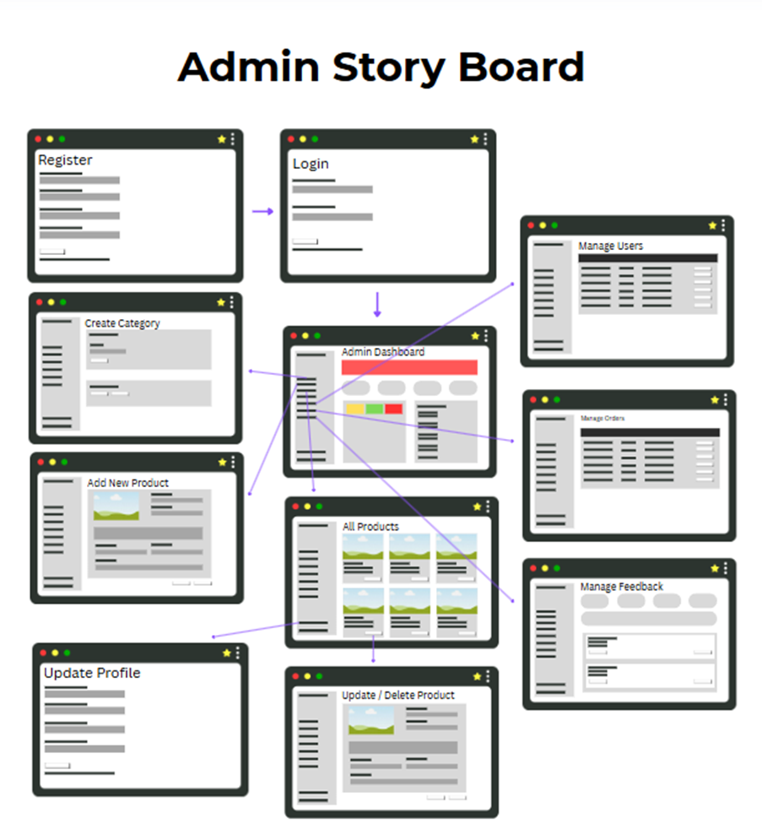
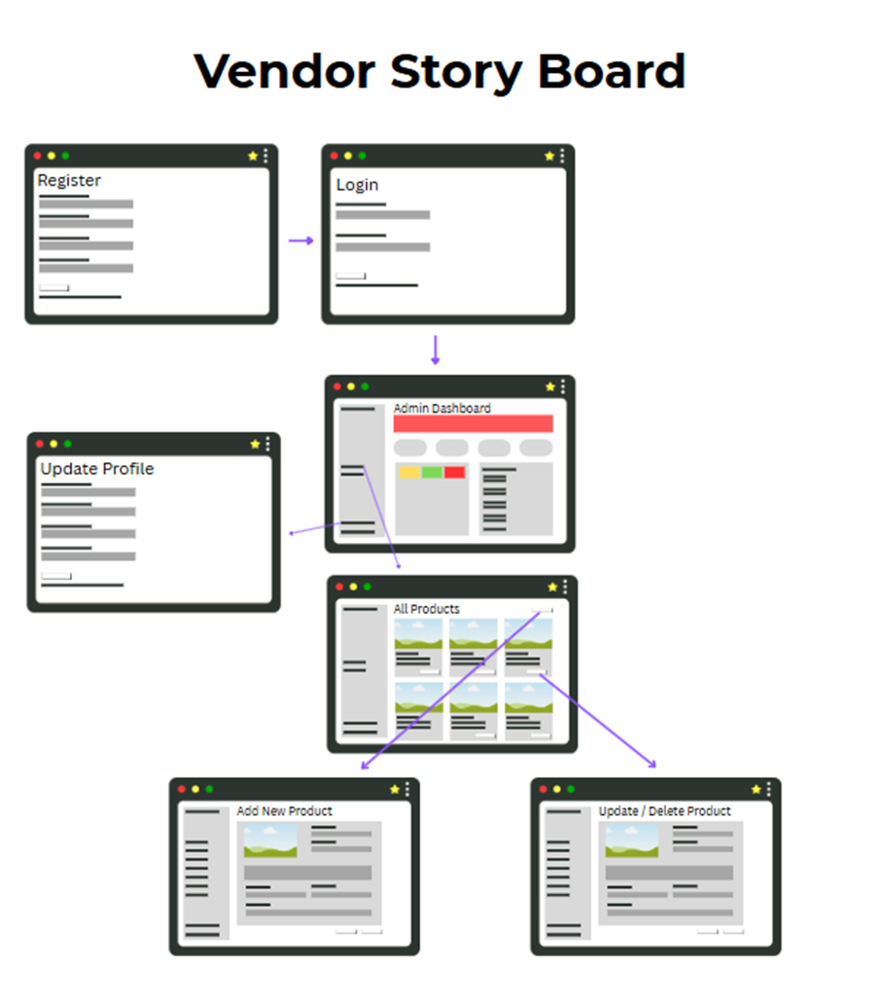

Slide 41
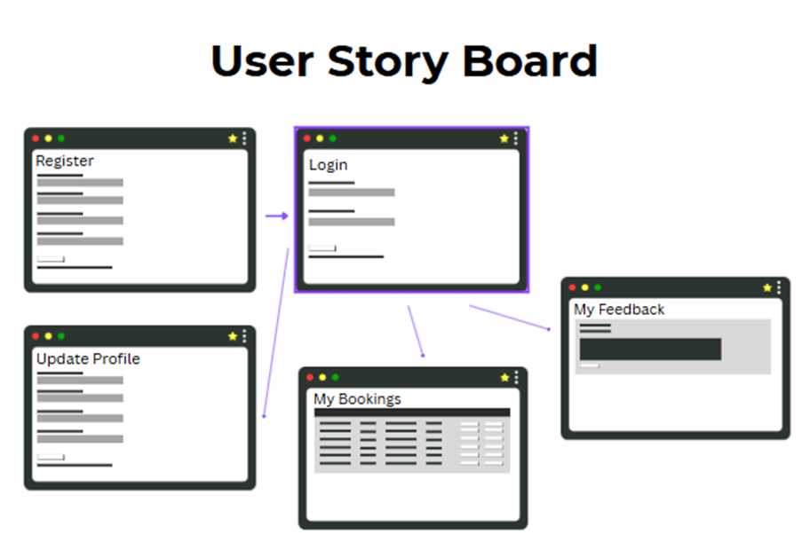

Slide 42
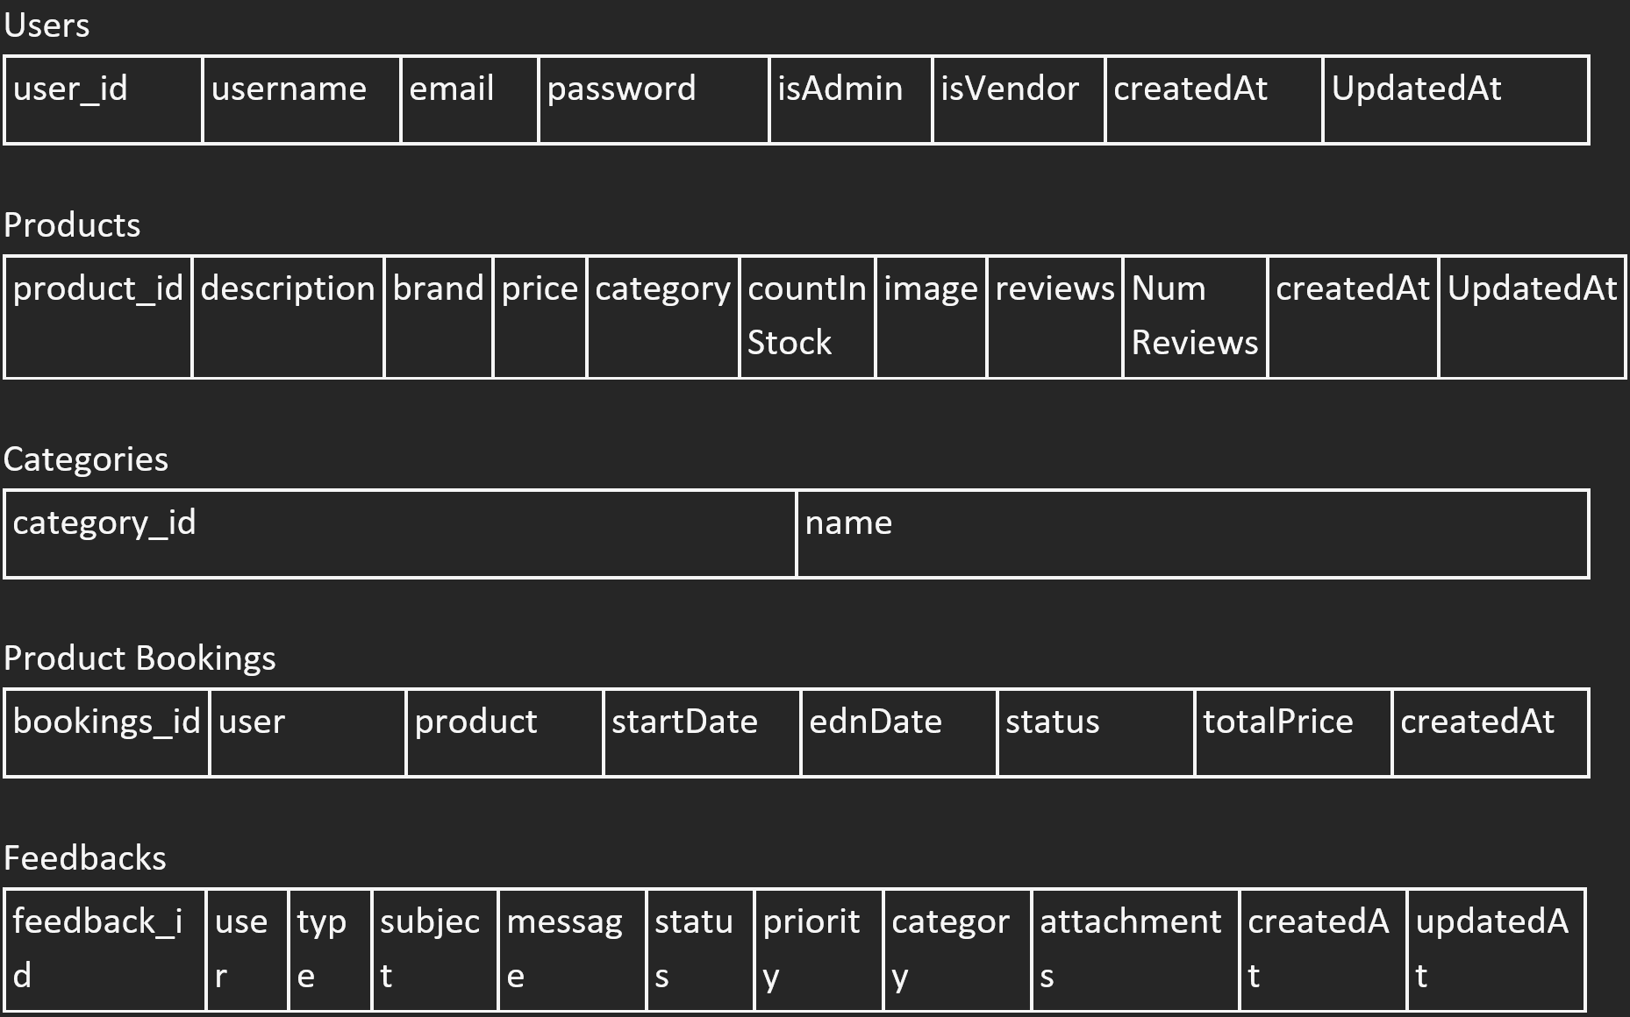
4.2 Input Data Forms
Client-side form validation is implemented using React Hook Form. Common validations include required fields, email format, and inline error display. Following the data created in MongoDB by NoSQL database the input form will be as following:
Pre-AES

Slide 43
4.3 OUtput Report Forms
Following the data created in MongoDB by NoSQL database the input form will be as following:
Post AES
Users:
{
"_id":{"$oid":"67f2fa6bcdd0be224f4af416"},
"username":"erna",
"email":"erna@gmail.com",
"password":"$2b$10$jVn4z85CFj61pkbbVeRiYeaNaKTtBtbvrMfmPJPKKpziZDATp7a v2",
"isAdmin":true,
"createdAt":{"$date":{"$numberLong":"1743977067696"}},
"updatedAt":{"$date":{"$numberLong":"1743977067696"}}
,"__v":{"$numberInt":"0"}
}

Slide 44
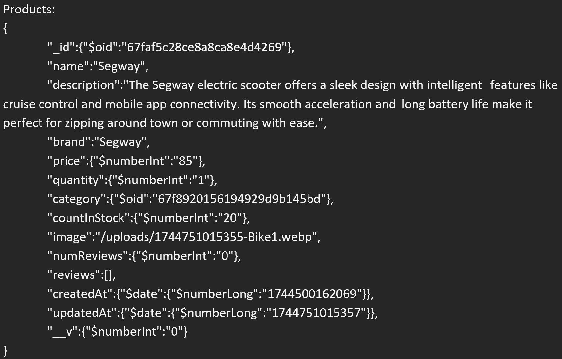

Slide 45
Product Bookings:
{
"_id":{"$oid":"67fed568d59f6ddf5d8fff0f"},
"user":{"$oid":"67fde730e28f040be6cf6c53"},
"product":{"$oid":"67fb468a958a3ef3a02ae3ae"}
,"startDate":{"$date":{"$numberLong":"1744761600000"}},
"endDate":{"$date":{"$numberLong":"1745366400000"}},
"status":"pending",
"totalPrice":{"$numberInt":"80"},
"createdAt":{"$date":{"$numberLong":"1744754024996"}}
,"__v":{"$numberInt":"0"}
}

Slide 46
Feedbacks:
{
"_id":{"$oid":"67ff04a744fe755c3a232434"},
"user":{"$oid":"67f2fa6bcdd0be224f4af416"},
"type":"general",
"subject":"Exceptional",
"message":"Exceptional service and user experience. Keep it up!",
"status":"pending",
"priority":"low",
"category":"website",
"attachments":[],
"createdAt":{"$date":{"$numberLong":"1744766119138"}},
"updatedAt":{"$date":{"$numberLong":"1744766119138"}},
"__v":{"$numberInt":"0"}
}

Slide 47
Categories:
{
"_id":{"$oid":"67f8920156194929d9b145bd"},
"name":"Bike Rental",
"__v":{"$numberInt":"0"}
}

Slide 48

5
Test Plan & System Implementation Plan

Slide 49
5.1 System Implementation Plan
The System Implementation plan is divided to 5 phase from development to production.
Phase 1 (Environment Setup)
Timeline of 1-2 week
Deploy frontend (React + TailwindCSS)
Deploy backend (Node.js + Express)
Configure MongoDB Atlas with access restrictions and backups
Enable environment variables and secure communication (HTTPS)
Phase 2 (System Configuration)
Timeline of 1 week
Set up user roles and permissions: Admin, Vendor and User
Configure bike categories, payment options, and rental rules.
Ensure data is displaying as intended in the website

Slide 50
5.1 System Implementation Plan
Phase 3 (User Training)
Timeline of 1 week
Host a live demo session to the member of the different access, and how to populate the data.
Phase 4 (System Testing)
Rigorously perform testing to identify and resolve any bugs before going live
Perform UAT (User Acceptance Testing) to gather feedback from the user and make relevant changes.
Timeline of 2-3 week
Phase 5 (Go-Live and Post launch support)
Communicate launch details to stakeholder
Create a communication channel for support tickets, feedback, and error logs.

Slide 51
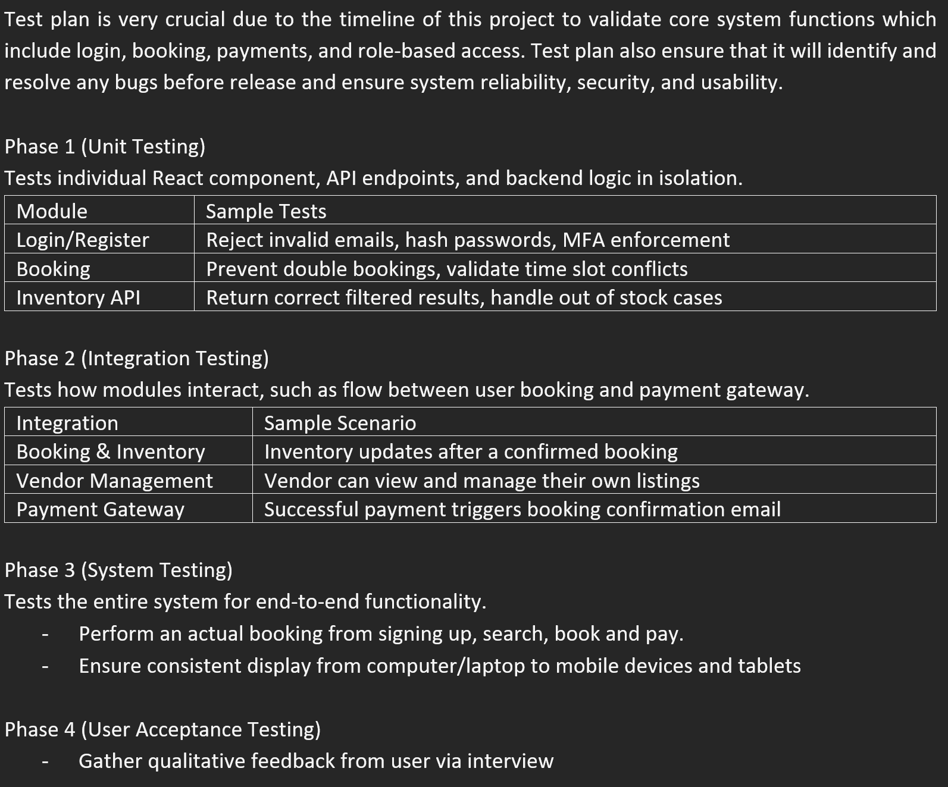
5.2 Test Plan

Slide 52
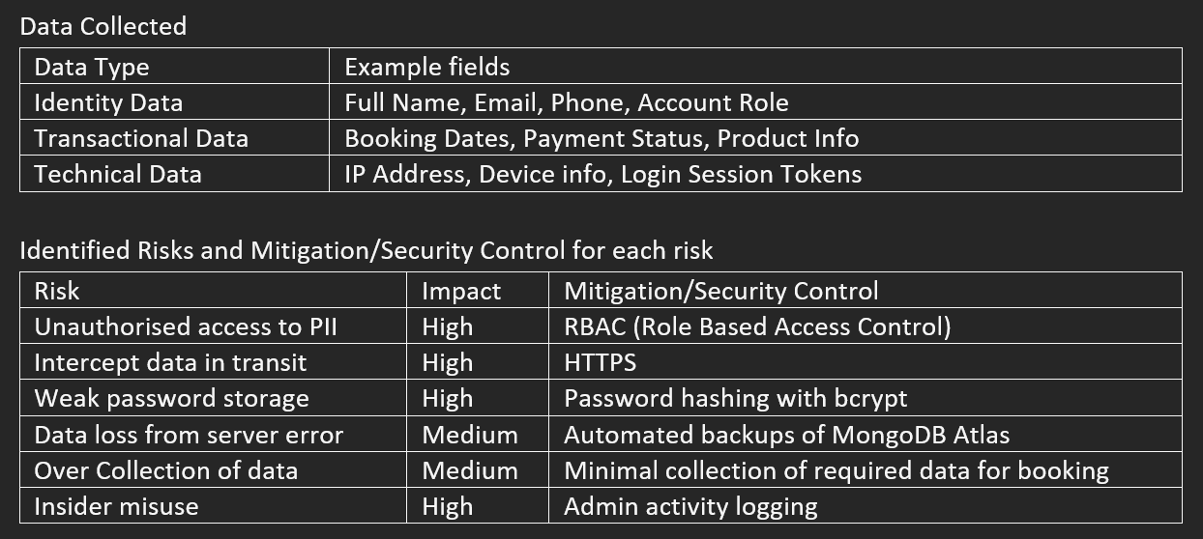
5.3 Data Protection Impact Assessment (DPIA)
Since the project is based on Sydney Australia it is important to comply with local regulations such as Australian Privacy Act 1988 and Australian Privacy Principles (APPs), a Data Protection Impact Assessment has been conducted for JBMS this is to ensure that JBMS are safeguarding sensitive user data. The data are processed to enable bookings, payments, and rental operations. Also to authenticate users and manage roles securely.

Slide 53
5.3 Data Protection Impact Assessment (DPIA)
Legal and Ethical Compliance
Ensure it is following Australian Privacy Act (1998) and APPs 1-13 OAIC (2024)
Ensure user are providing consent before data collection
User can request account/data deletion
Ensure data are safely stored and not share to any third-party without consent
Privacy policy are publicly available on the website platform

Slide 54

6
Feedback

Slide 55
Feedback from the lecture
Based on the feedback received from the lecture, changes have been made accordingly.
Feedback: “Provide description for each table and diagram not just pasting the picture in without any explanation.”
Action taken: Brief explanation has been provided to ensure the reader know and understand what the purpose of the picture, table and diagram is.
Feedback: “Start working on the actual website development based on this report.”
Action taken: Website has been generated based on the content of the document though it is still a rough start, but progress has been made.
Feedback: “Ensure adequate reference is provided.”
Action taken: Beside the 5 minimum reference as required by the assignment adequate amount of reference has been included to ensure the document are citing relevant sources.

Slide 56
Thanks!
Do you have any questions?
https://jot-bikes.vercel.app/
02 111 000 11
https://github.com/HendraLim1/ProjectCapstone/blob/28d3a4b2c355a4da7fefa8fa0c972255912246fe/WIP%20Report/Group%204%20Final%20SRS.docx

